Slide 1

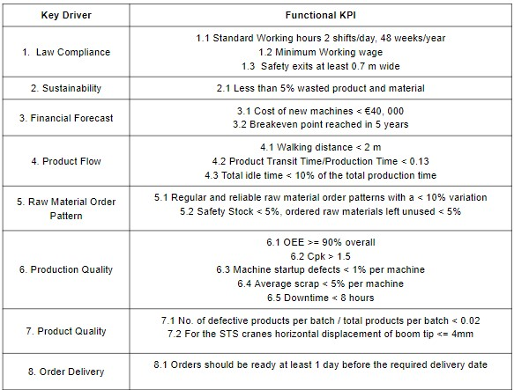


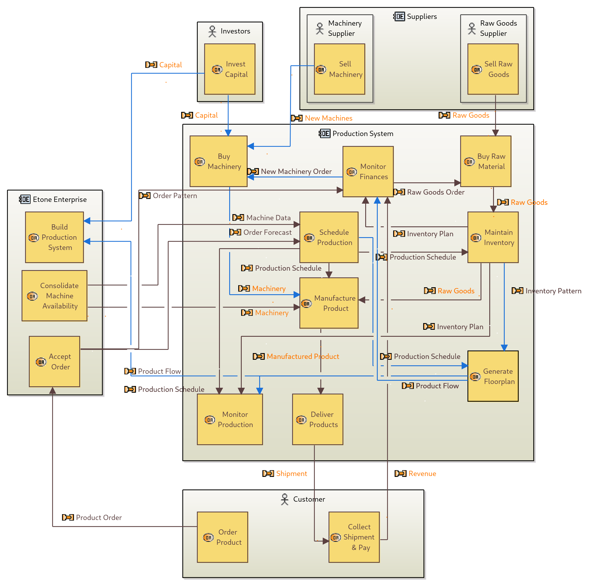
ME Module 11: Production Systems Engineering
Group 2 | Faculty of Engineering Technology (ET)
University of Twente, Netherlands | 2022
Systems Engineering
Kirtan Premprakash Patel (s2935848),
Sally Ayman Ahmed Mohamed (s2273144)
Problem Statement
N² Architecture
Etone Enterprises is an Original Equipment Manufacturer, and wants to enter the market of construction elements to broaden their product portfolio. They have found a new customer, Port of Ashdod, that requires the design and production of construction parts for STS cranes. A larger redesigned production facility is required to fully accommodate its current and new production lines.
The principles of Systems Engineering are used in order to develop, integrate & test the different operations involved in the production system. This is done so that the Production System can be efficiently redesigned and functioned to meet the production requirements without compromising the quality of the products and production.
Etone |  | 2 |  |  | 3
 | P.S. |  |  |  | 14 |  |  | 12
 |  | PP&C | 4 | 4 | 4
7 |  |  | PF&D | 6 | 7
8 |  |  | 5 | F&IM | 5 | 8 |  | 5
9 |  | 15 |  |  | QC&RM | 9
10 |  |  |  |  |  | Investor
1 |  |  |  | 13 |  |  | Customer
 | 11 |  |  |  | 14 |  | 12 | S & D
System Requirements
After Performing a stakeholder analysis and defining key drivers to each stakeholder, the system requirements were split into functional and non functional KPIs.
Non-Functional KPI: Efficiency, Reliability, Flexibility, Maintainability, Cost Effectiveness
Abbreviations :
PS : Production System
S&D : Suppliers & Distributors
PP&C : Production Planning & Control
PF&D : Production Flow & Design
F&IM : Finance & Inventory Management
QC&RM : Quality Control & Risk Mitigation
The orange interfaces are Materials.
Raw Material
Manufactured Product
The other interfaces are Information.
Inventory Plans, Order Plan
Performance Reports, Financial Plans
The green interfaces are information interfaces activated when a failure occurs.
Lack of workforce on certain days
Lack of inventory
Unexpected Machine Failure
The blue interfaces are information interfaces exist during the initial setup.
Existing Machine Data
Factory Layout
1. Product Order
2. Order Forecast, Existing Machine Data.
3. Performance Requirements
4. Production Sequence & Schedule
5. Inventory Pattern & Order Plan
6. Land Requirements
7. Product Flow & Factory Layout
8. Financial Projections
9. System & Product Performance
10. Investment Capital
11. Raw Material
12. Manufactured Product
13. Revenue
14. Failure
15. Risk & Maintenance Protocol
Verification
Operational Flow
 | Functional KPI
kd | 1 |  |  | 2 | 3 |  | 4 |  |  | 5 |  | 6 |  |  |  |  | 7 |  | 8
kpi | 1 | 2 | 3 | 1 | 1 | 2 | 1 | 2 | 3 | 1 | 2 | 1 | 2 | 3 | 4 | 5 | 1 | 2 | 1
T1 | X | X |  |  | X | X |  |  |  | X
T2 |  |  | X |  |  |  | X |  |  |  | X |  |  |  |  |  |  |  | X
T3 |  |  |  |  |  |  |  | X | X |  |  | X | X
T4 |  |  |  |  |  |  |  |  |  |  |  |  |  | X | X | X | X | X
T5 |  |  |  | X
Regular
Initial Setup
Information Flow*
Material Flow
*excludes failure interfaces
Test Protocol 1 : Unit Testing
[T1] Test 1 : Documentation Check
[T2] Test 2 : Floor Inspection
[T3] Test 3 : Efficiency Check
[T4] Test 4 : Quality Check
[T5] Test 5 : Waste Check
Test Protocol 2 : Integration Testing
Test 1 : Virtual Environment Testing
Test 2 : Real Life Monitoring
Non-Functional KPIs :
Efficiency
Reliability
Flexibility
Cost Effectiveness
Test Protocol 1 is meant for the testing of the Functional KPIs and Test Protocol 2 is for testing the Non-Functional KPIs.
Conclusion
The Systems Engineering approach proved beneficial in the design of a new Production System. Along with successful integration, our efforts were to distribute the workload equally among subsystems. Many performance indicators have been excluded, which can be included and worked on further.
From our System Verification and Integration Analysis, we conclude that the designed Production System was not able to meet the required OEE and Cpk values however, the system is flexible, robust, failure modes are limited and there is room for expansion. The OEE and Cpk values can be improved by further iteration of the production layout and product flow.
References [1] Systems Design and Engineering - G. Maarten Bonnema, Karel Th. Veenvliet, Jan F. Broenink
[2] A3 Architecture overviews: A tool for effective communication in product evolution - P. Daniel Borches
[3] System Architecture Modeling with the Arcadia Method - Pascal Roques
UNIVERSITY OF TWENTE.

